Slide 1

Diabetes Prediction Website
The website is to predict whether a person has diabetes by input variable features.

Slide 2

Project goal
The project goal of this synthetic project is to develop a user-friendly and effective website using machine learning that enables medical professionals to predict the risk of diabetes in their patients accurately. This platform aims to empower doctors by providing them with advanced predictive analysis tools, allowing for early detection and intervention to improve patient outcomes and promote better health management practices.

Slide 3
Website Contents
This website includes five pages:
Home: Homepage contains the title of the website, a little description of the title, and the links of all other pages.
Diabetes Prediction: This is the prediction page, which shows the prediction result by calculating the inputs
BMI Calculator: If someone wants to know their BMI based on their height and weight, they can to this page and this page will give them their BMI result.
Suggestion: This page is about type2 diabetes and the suggestions about it
About: This page contains the description about this website

Slide 4
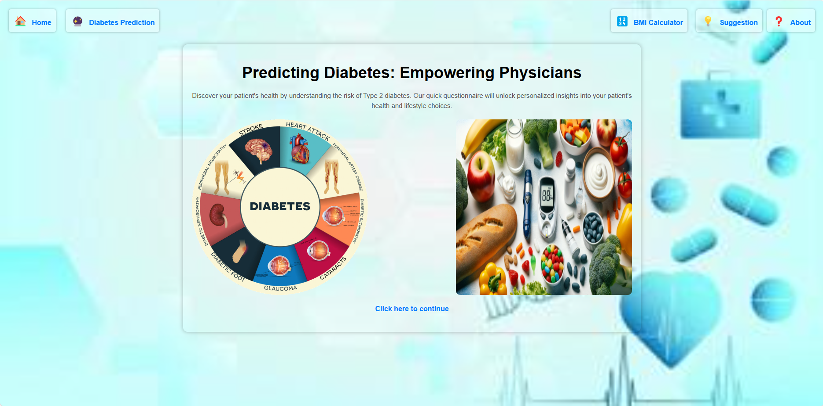
Home page
This is the home page looks like.

Slide 5
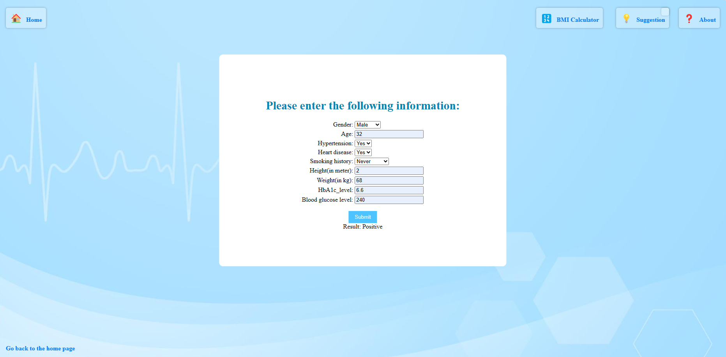
Prediction page
Here is the Diabetes Prediction page:
The user can put the inputs here. After giving all the inputs, user can click the submit button, then the page will show the result based on the inputs.

Slide 6
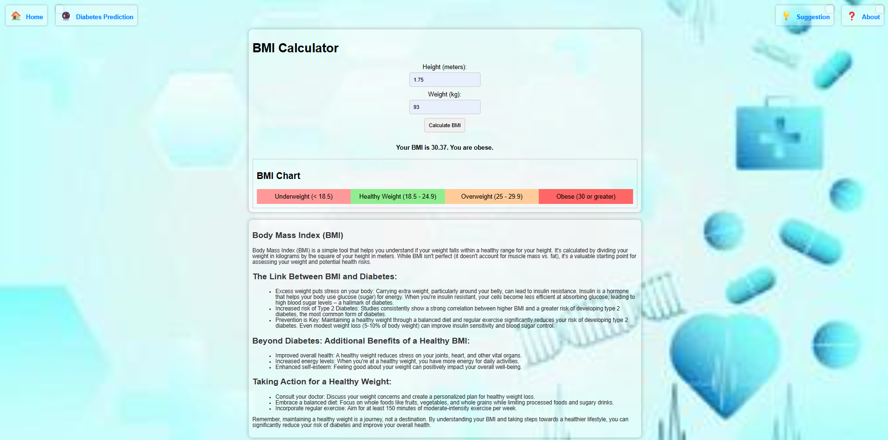
BMI Calculator page
This is the BMI Calculator page:
The user can measure the BMI from here. It will also show the health status based on the BMI chart.

Slide 7
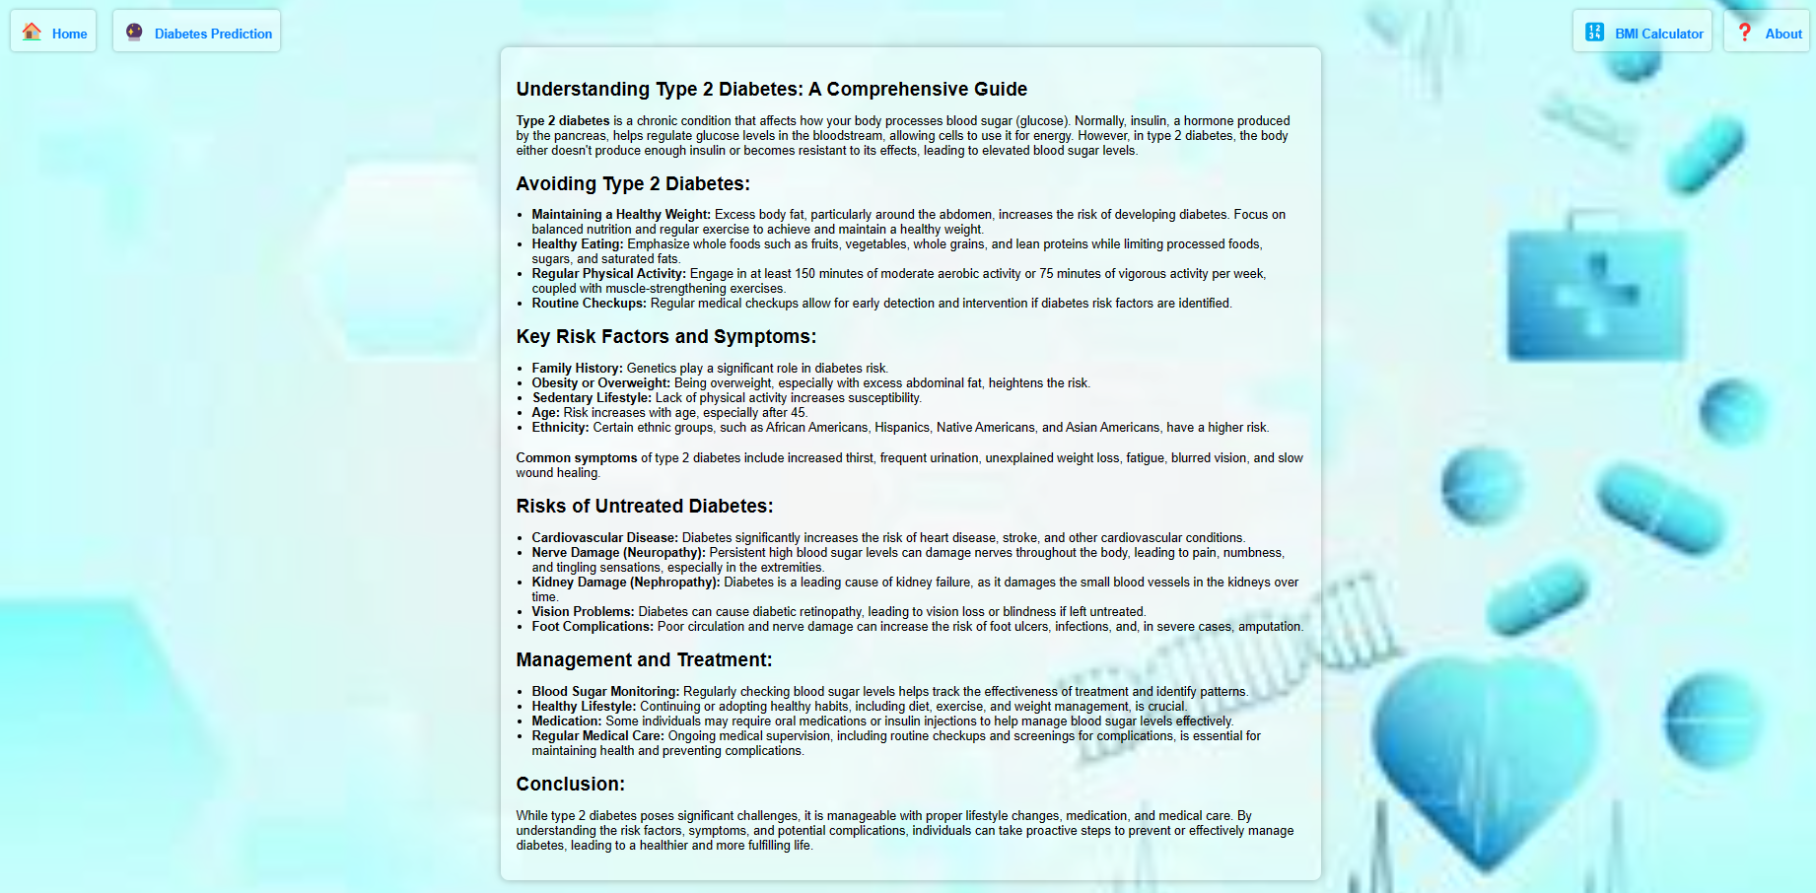
Suggestion page
This is the Suggestion page:
The page is about what type2 diabetes is, how to prevent it, or what measures to take if someone is positive. Also, there is a discussion about the risk factors of untreated diabetes. Doctors can use these description as a suggestion for their patients.

Slide 8
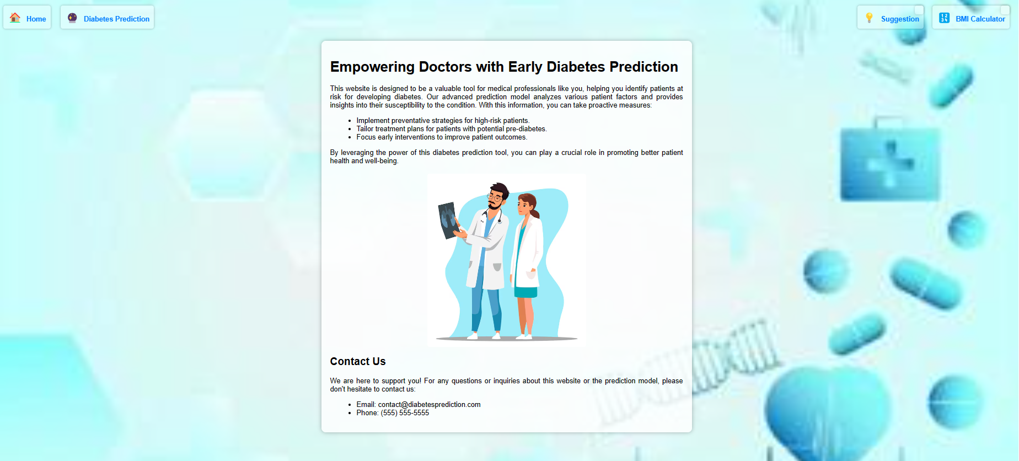
About page
This is the About page:
The page describes about the website itself along with the goal of the website. It contains the contact information at the bellow of all the description. As this is a demo project so far, I added the demo contact information.

Slide 9
Software requirements
Python
Anaconda
IDE: Pycharm
Microsoft edge for web browser

Slide 10
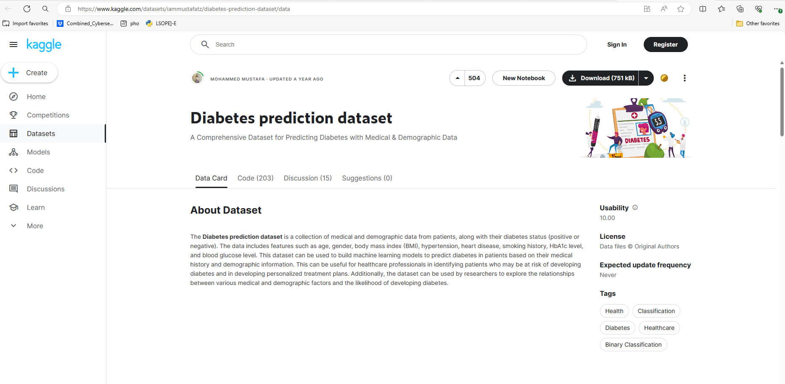
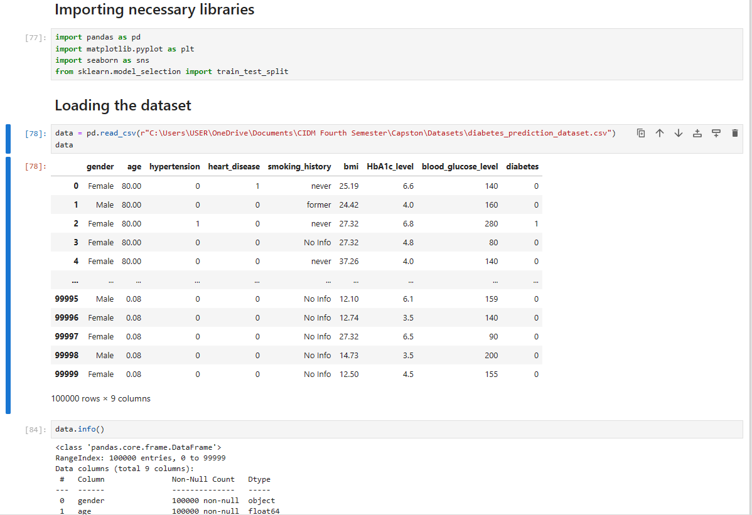
Data collection, preparation, load, and model build up
The diabetes prediction dataset was sourced from Kaggle.The link of the page is: Diabetes prediction dataset (kaggle.com)
Following data collection, Jupyter Notebook was utilized for tasks such as data importing, cleaning, and loading. Subsequently, missing values were checked, and the dataset was trained. Model construction ensued, and predictions were made leveraging a machine learning model, specifically the Random Forest Classifier.

Slide 11

Website interface design
After the model buildup, PyCharm was employed for website design, while Microsoft Edge served as the web browser for testing and browsing.
Using PyCharm, five HTML templates were created to correspond to the five pages of the website.
There were views.py directory for defining all the functions and the other functional codes were added which were in the Jpyter Notebook.
Microsoft edge was used for web browsing for the website
That is how this website was created.

Slide 12
Future Potential of "Diabetes Prediction" website
This Diabetes prediction website can serve as a powerful and indispensable tool for medical professionals in diabetes prediction and management. Its advanced predictive model and user-friendly interface can facilitate accurate risk assessment for patients, enabling doctors to intervene early and implement personalized prevention and treatment strategies. By harnessing the latest technology and data analysis techniques, the artifact would significantly improve patient outcomes, reduce the incidence of diabetes-related complications, and ultimately contribute to better population health. Moreover, its widespread adoption can lead to a cultural shift towards proactive health management, empowering individuals to take control of their well-being and leading to overall improvements in healthcare delivery.

